Slide 1
Visual Studio
Microsoft Visual Studio is an Integrated Development Environment (IDE) from Microsoft.
It is Used to Develop Websites, Web Services and Mobile Applications.
Programming Languages: C#, C++, Visual Basic, Visual Basic.NET, J#.

Slide 2
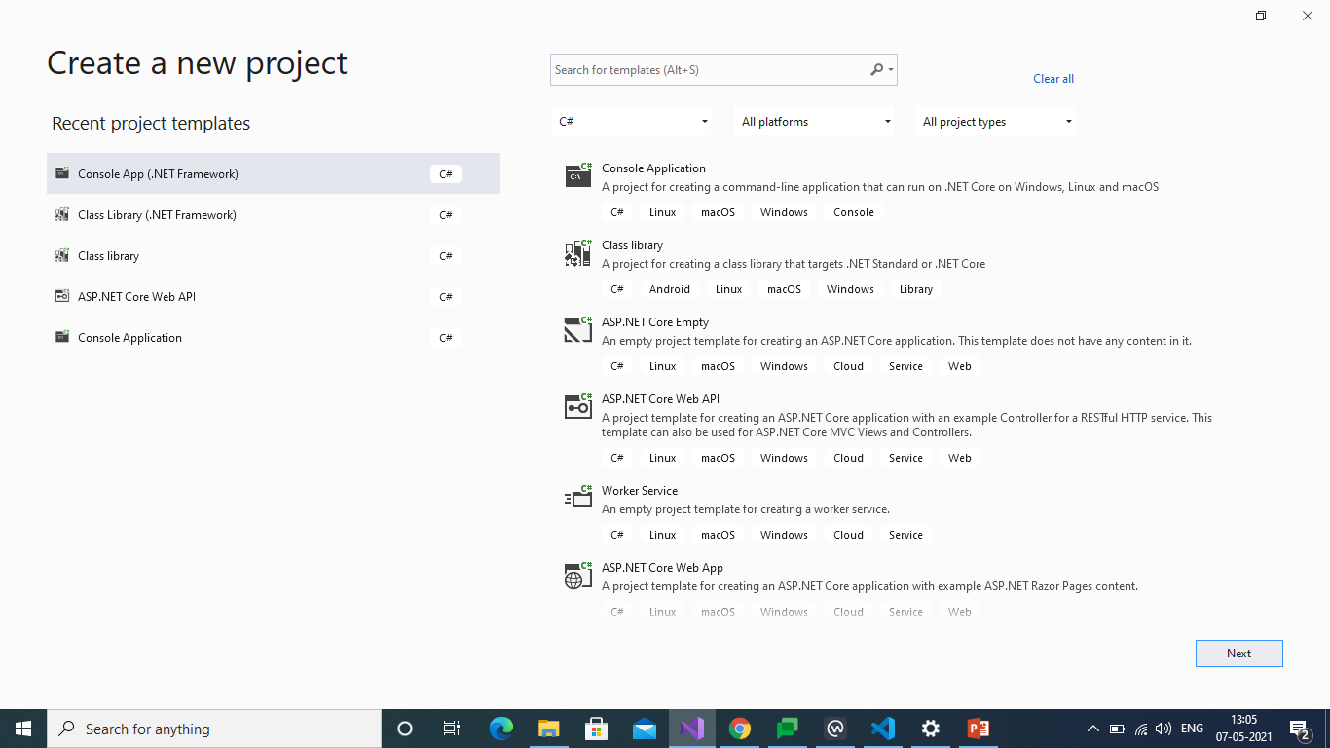
How Create a New Project

Slide 3
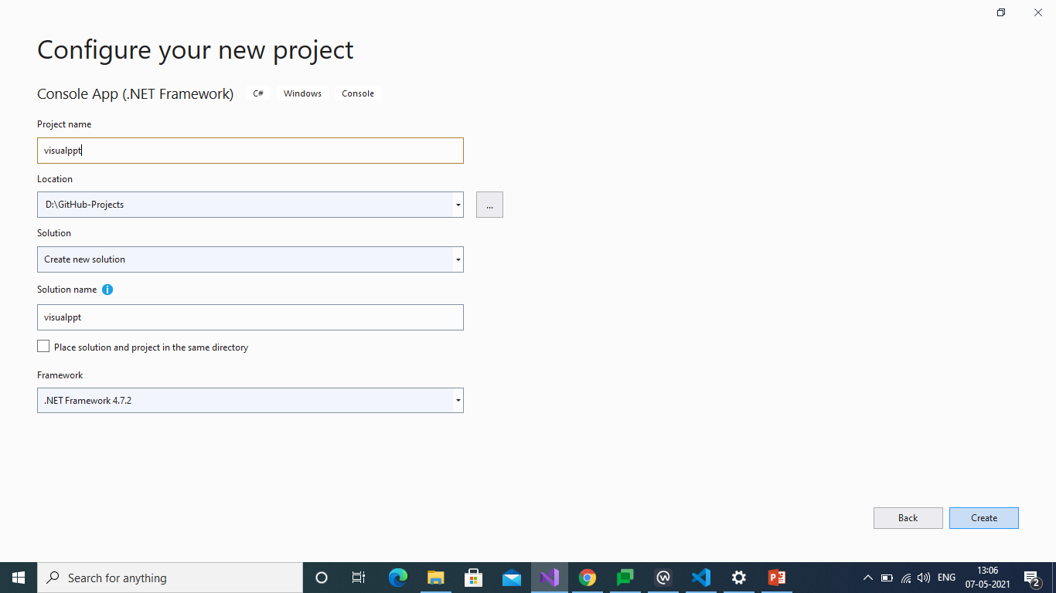
How to Configure That Project

Slide 4
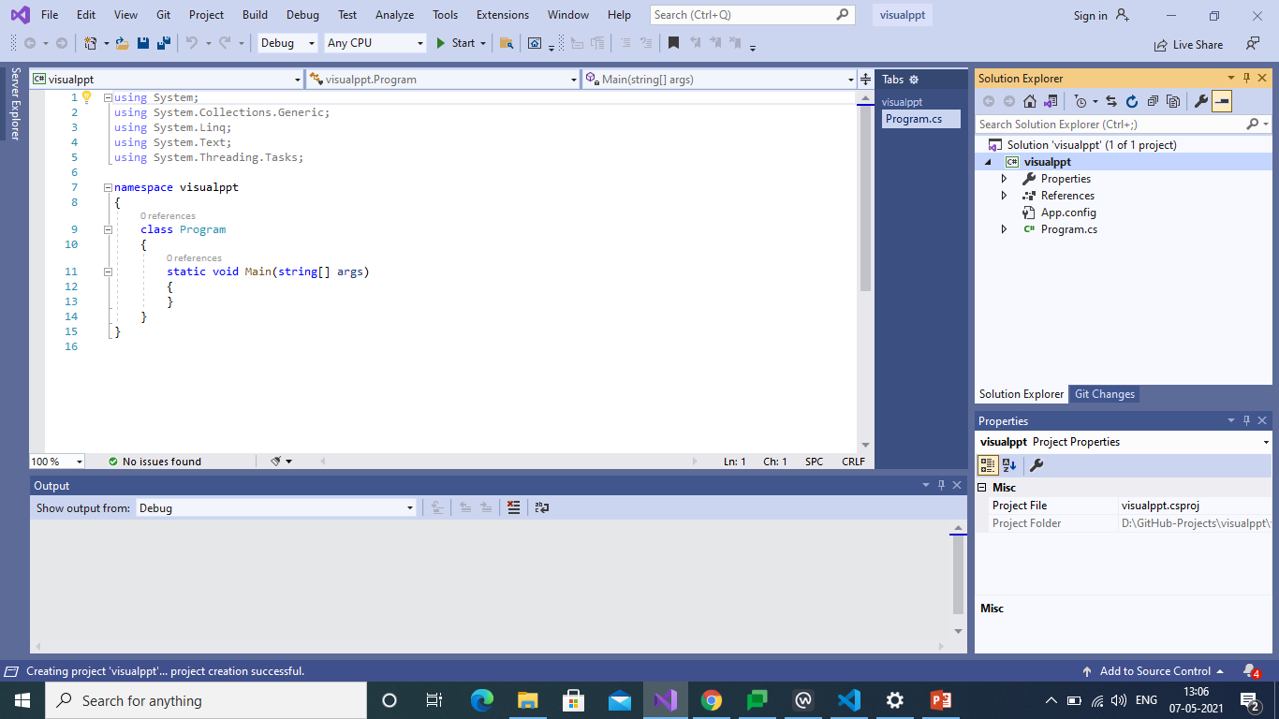
Project will be Appeared Basic Structure

Slide 5
Visual Studio Code
Visual Studio Code is a Freeware Source-code Editor made by Microsoft for Windows, Linux and mac OS.
It is Supported for Debugging and Syntax Highlighting.
And it has Intelligent Code Compiler.
It is Easy to Use.
It Contains Friendly Environment with understandable features.

Slide 6
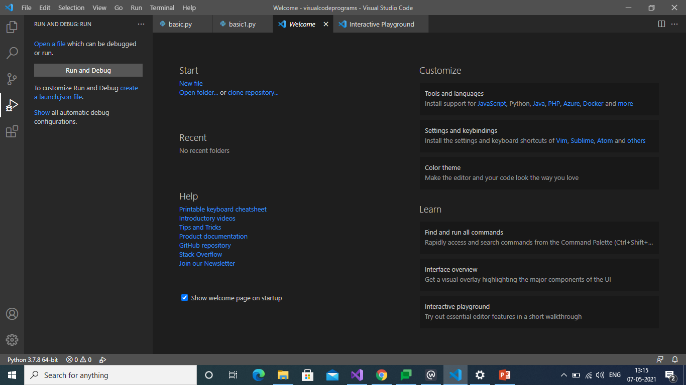
Welcome Page

Slide 7
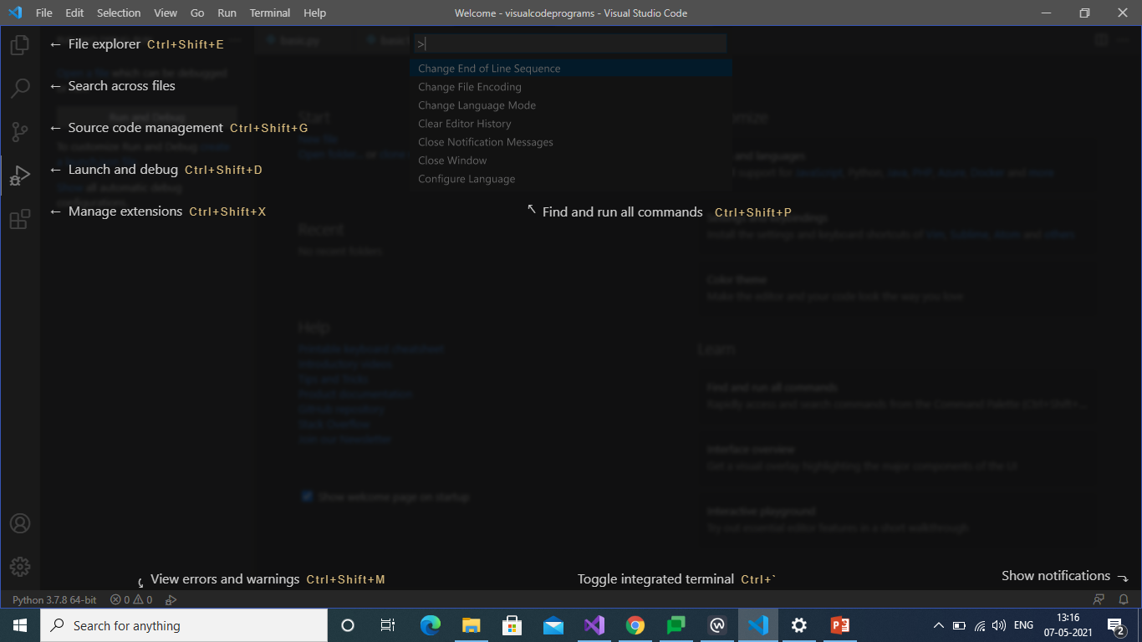
Interface Overview

Slide 8
GITHUB
GitHub is a code hosting platform for version control and collaboration.
It lets you and others work together on projects from anywhere.
GitHub contains essentials like repositories, commits, and Pull Requests.
Team members can work on files and easily merge their changes.

Slide 9
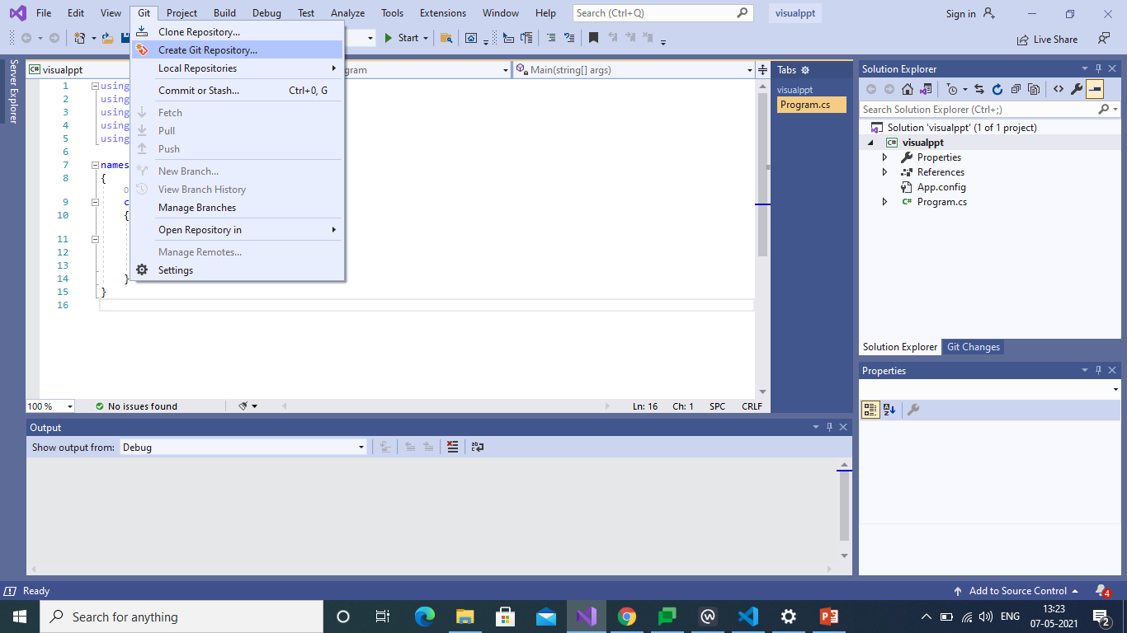
Connection Repositories

Slide 10
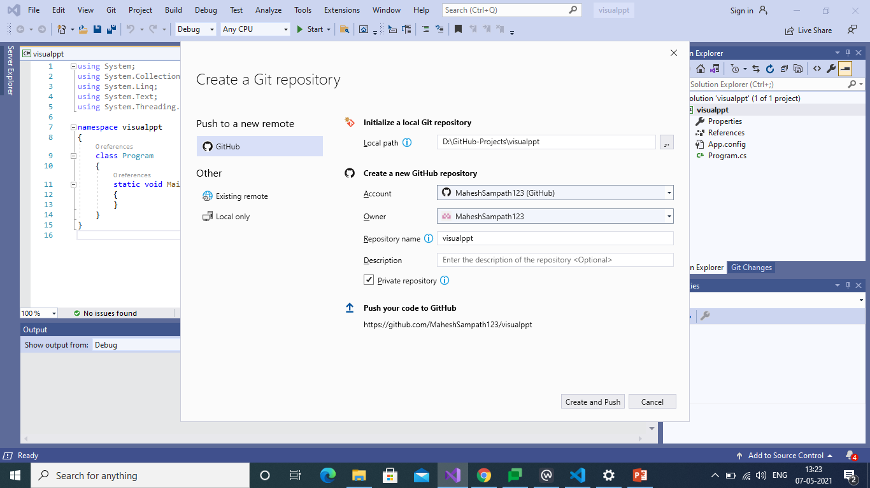
It will show the Repository Path

Slide 11
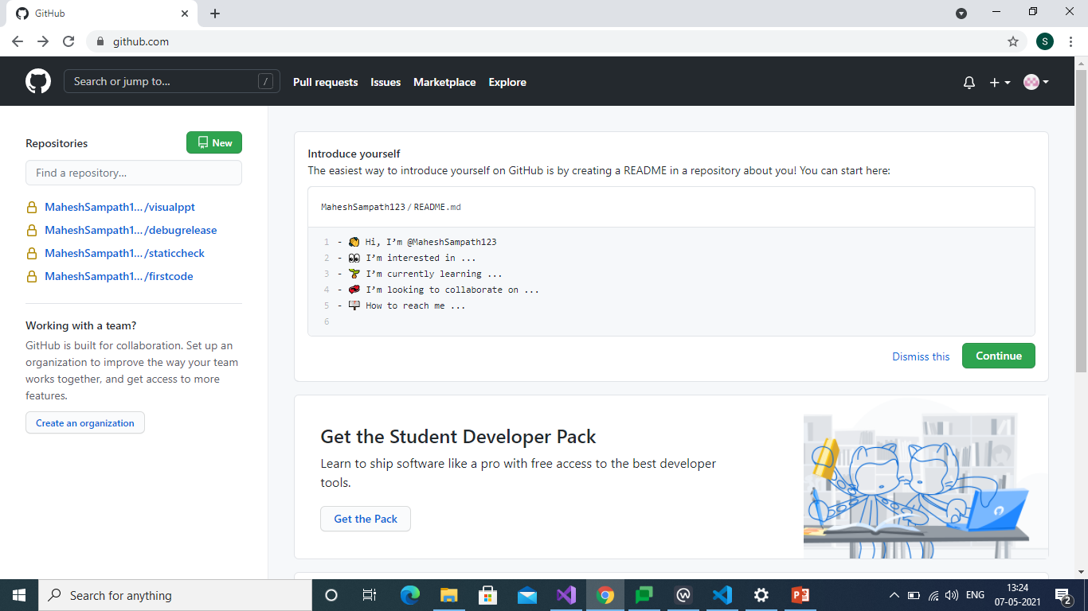
After Creation We Can See Repository

Slide 12
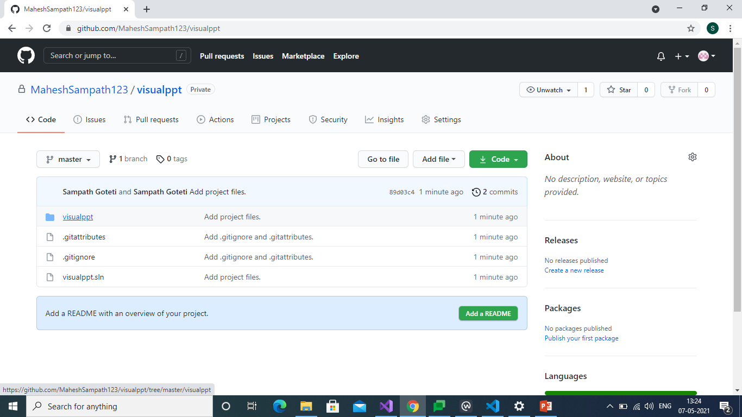
Files in our Repository

Slide 13
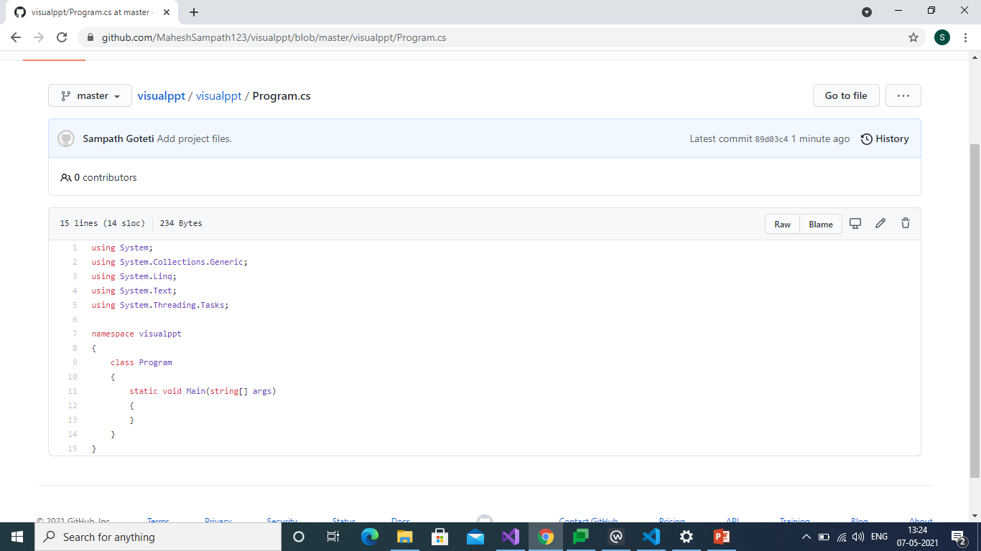
Finally We can see our Code

Slide 14
BITBUCKET
Bitbucket is our Git repository management solution designed for professional teams.
It gives you a central place to manage git repositories, collaborate on your source code and guide you through the development flow.
Pull requests with in-line commenting for collaboration on code review.

Slide 15
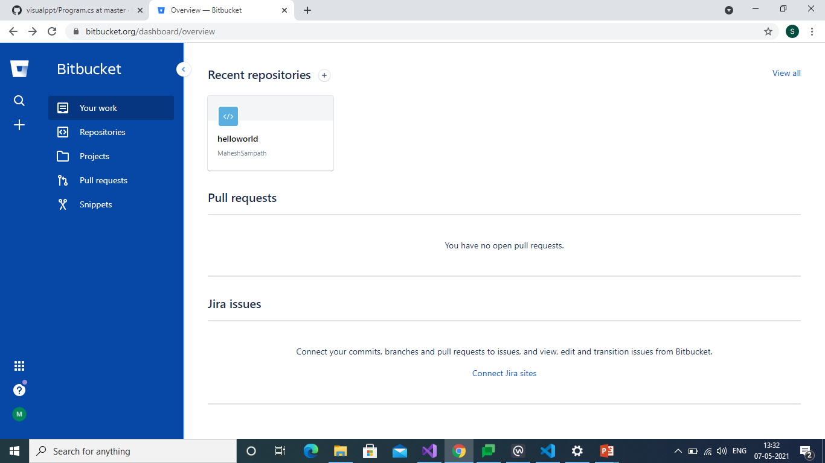
First Page

Slide 16
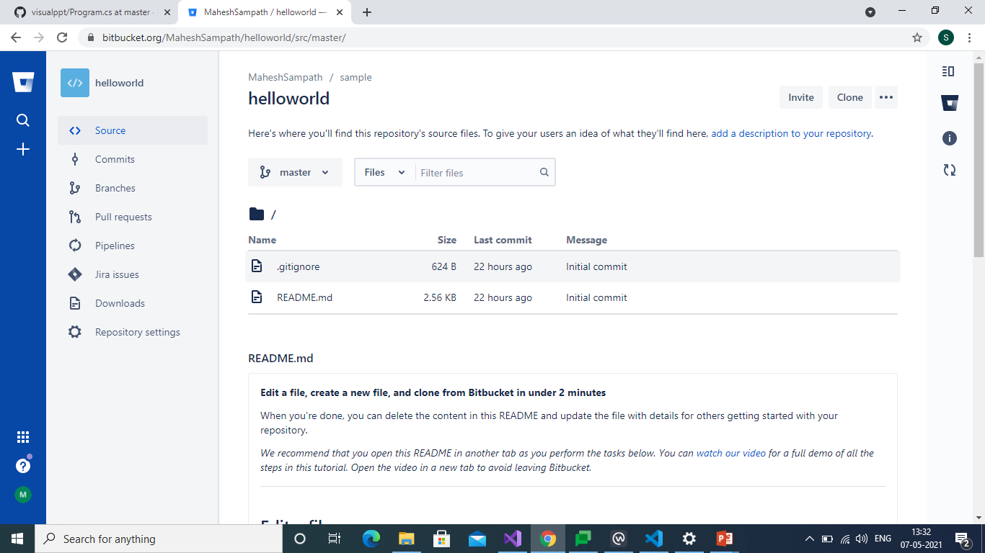
We can Create Repository

Slide 17
THANKYOU

